Slide 1


Mini Project (II Year)
ABO Blood Group Detection Through Image Processing Technique
Under the Supervision of Madhvi Gaur Ma’am
Presented By : Palak Sharma & Pranav Gupta

Slide 2

Introduction
Blood types were discovered by Austrian Karl Landsteiner in 1901. ABO blood group system and the Rh D blood
group system are the most important blood group system used for determining blood group of a person and the test used for determining the blood group is blood typing. The blood groups are defined by the presence or absence of a specific antigen on the surface of a red blood cell. There are four ABO blood groups: A, B, AB and O. They refer to the presence of different antigens on the red blood cells and antibodies in the blood. Blood group O means you have neither antigen present on the surface of RBC and antibodies A and B in the blood, but blood group AB means you have both the A and B antigens present and no antibodies in the blood. Blood group A has antigen A present on the surface and antibody B in the blood, while blood group B has antigen B present on the surface and antibody A in the blood. Referring to Rh D blood group system, one more antigen called Rh D is involved while determining the blood group. If D antigen is present on the red blood cells of a person then he/she is Rh D positive, while one who does not have D antigen on the red blood cells is Rh negative.

Slide 3
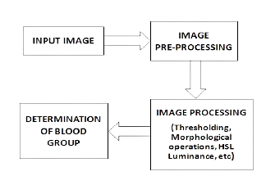
Proposed System
Source: http://www.ijser.org

Slide 4
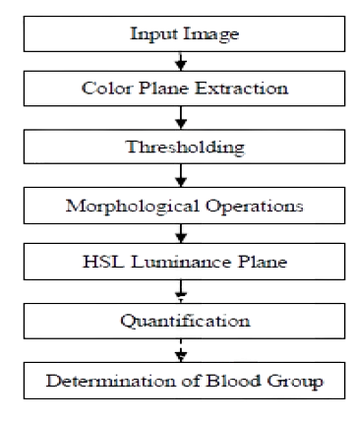
Methodology
Source: http://www.ijser.org

Slide 5
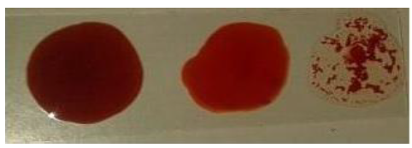
Data Collection
Three samples of blood are taken on a slide, each mixed with reagent anti-A, anti-B, anti-D respectively and images of slide are taken. These images are digital images stored in JPEG format and they are pre-processed using colour plane extraction.
Input Image
Source: http://www.ijser.org

Slide 6
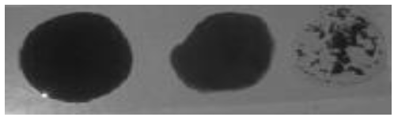
Color Plane Extraction
The colour plane contains colour information in images. ‘Comparing’ sections in an image is the concept used in image
processing. Comparison in Gray scale involves simple scalar algebraic operators. In colour plane extraction, we first convert the RGB image in to a gray image and then filter the obtained result using median filtering.
Pre-processed image
Source: http://www.ijser.org

Slide 7

Thresholding
Thresholding operation in image processing is used to create binary images. The gray scale samples are clustered into two parts as background and object. In this case, multilevel thresholding is performed using Otsu’s method. More than one threshold are determined for a given image and segmentation is done creating certain regions. One background with many objects is the result of this multilevel thresholding. It is a clustering-based image thresholding.
Thresholded Image
Source: http://www.ijser.org

Slide 8

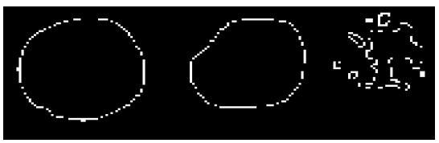
Morphological Operations
Morphology is a tool of extracting image components that are useful in the representation. In morphological operation, there are two fundamental operations such as dilation and erosion, in terms of the union of an image with translated shape called a structuring element. Here, closing operation is performed where dilation is followed by erosion. Also, edge detection using Canny edge detection technique is performed. Morphological operations are used to eliminate noise spikes and ragged edges.
Segmented image
Edge detection
Source: http://www.ijser.org

Slide 9
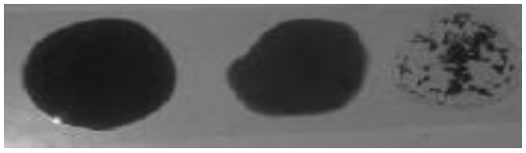
HSL Plane
HSL plane stands for Hue, Saturation and Luminance. It is the representation of RGB color model. Hue is expressed in a
degree around a color wheel, while saturation and brightness are set as a percentage. Figure 8 shows the result of HSL plane.
HSL Plane
Source: http://www.ijser.org

Slide 10
Technologies Used
The below mentioned technologies will be used for the development of the ABO Blood Group Detection through Image Processing.
01. Front-End Technology
02. Back-End Technology
03. Machine Learning
  HTML
  CSS
  Javascript
  UI/UX
  MATLAB
  Javascript
  Python
  MATLAB
  Image Learning Techniques
  Mathematical Expressions for Quantification

Slide 11



Benefits of this Project
Accurate job analysis is crucial for effective recruitment. Our policy emphasises:
Automated systems can classify blood types quickly (within seconds), significantly speeding up the process compared to traditional laboratory methods, which is crucial in emergency situations.
Once developed, the system can handle large numbers of samples with minimal human intervention, making it scalable for use in hospitals, labs, and blood banks while reducing labor costs and manual errors.
Don't have to wait for your blood test report to arrive, as this system gives you instant blood group results. It analyzes samples in seconds, making the process faster and more efficient, especially during emergencies.

Slide 12

Conclusion
The system is developed in a robust manner so that it is
unaffected by the exceptional conditions. The software
developed in image processing is efficient and it effectively
detects the occurrence of agglutination and consequently the blood group of the patient in a short interval of time. The system would achieve high percentage of sensitivity and specificity which will be useful in determining the blood group in emergency situations.

Slide 13

Thank You

